Slide 1
Machine Learning Algorithms (IV)
Master´s in Applied Artificial Intelligence
Luís Ferreira
lufer@ipca.pt

Slide 2
Overview
Part I
Artificial Intelligence and Machine Learning
Foundations
Part II
Machine Learning
Part III
Machine Learning Algorithms
Parte IV
Deep Learning & Neural Networks
Parte V
Building a ML Model

Slide 3
Part IV
Machine Learning Algorithms
Competencies to be acquired:
Choosing ML Algorithms
Create Classification ML models

Slide 4
Part IV: MLA
ML (Review)
Type of ML Algorithms
  Supervised ML Algorithms (SVL)
    Regression, Classification, Forecasting
  Unsupervised ML Algorithms
    Clustering, Dimensionality Reduction
  Semi-Supervised ML Algorithms
  Reinforcement ML Algorithms
Notes:
https://labelyourdata.com/articles/how-to-choose-a-machine-learning-algorithm

Slide 5
Part IV: MLA
Modelling
Choosing the best estimator/algorithm
  Classification problem - predicting a category (it will rain or not)
  Regression problem – predicting a number (the temperature)

Slide 6

Part III: MLA
Modelling
Choosing the best estimator/algorithm
  In Sklearn refers Algorithms or Machine Learning Models as “estimators”
  Classification problem - predicting a category (it will rain or not)
  Regression problem – predicting a number (the temperature)
https://scikit-learn.org/stable/tutorial/machine_learning_map/index.html

Slide 7
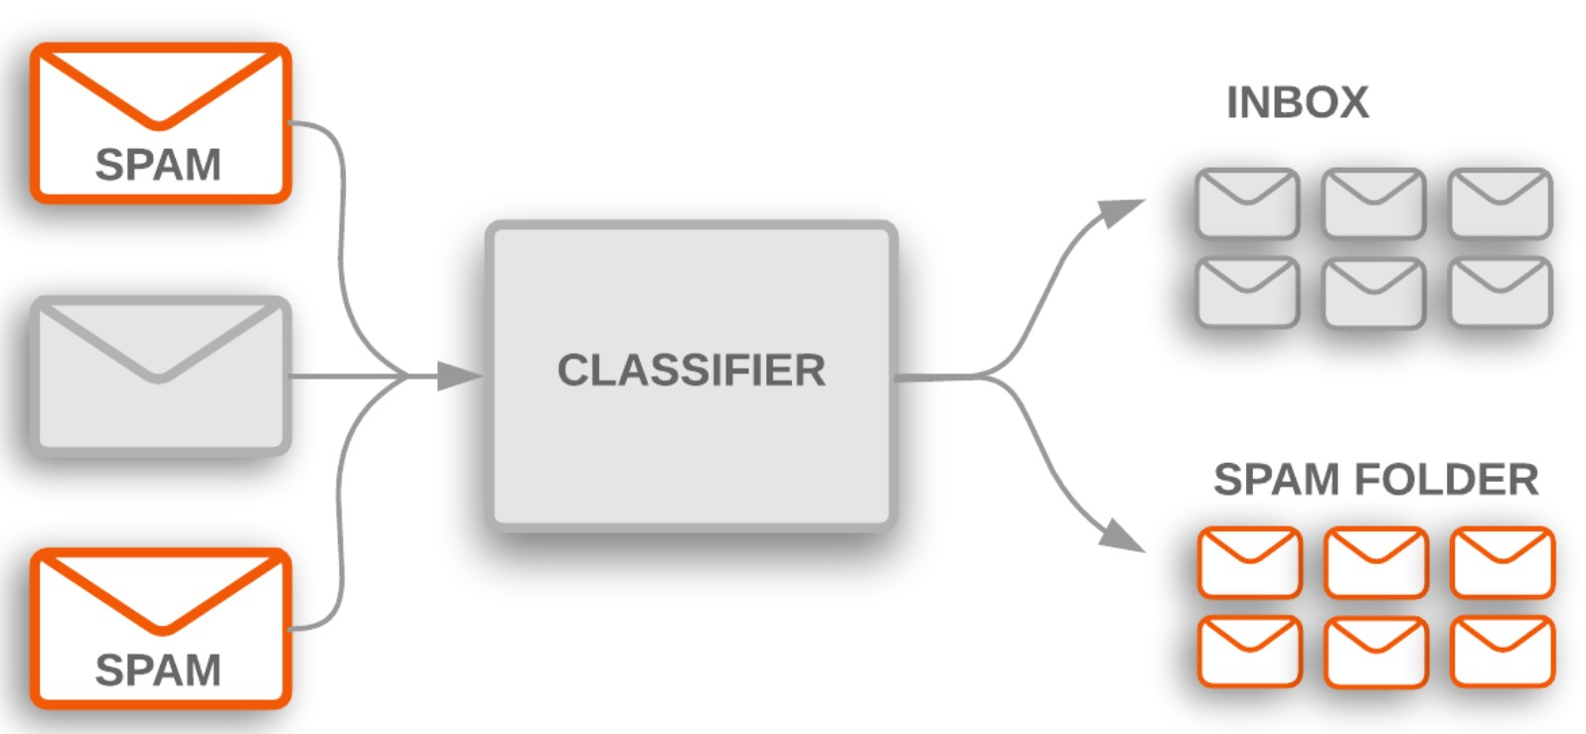
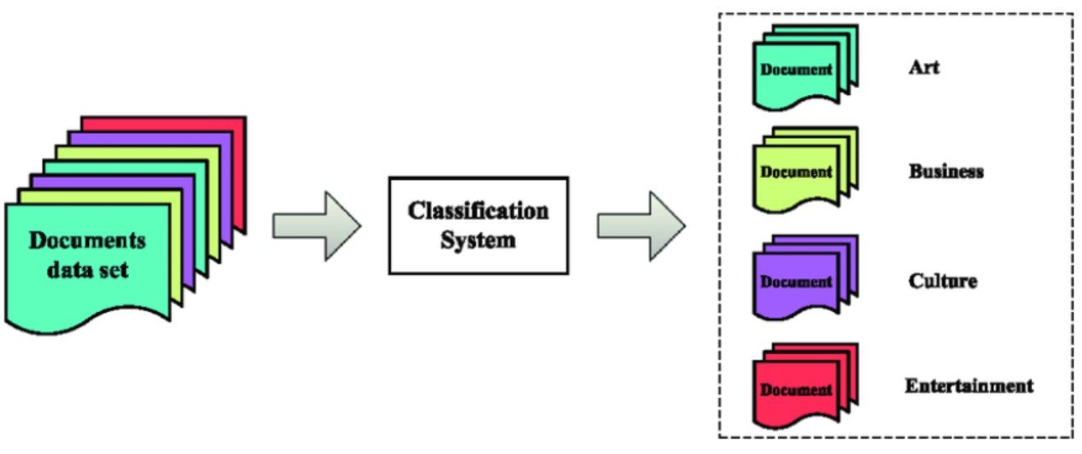
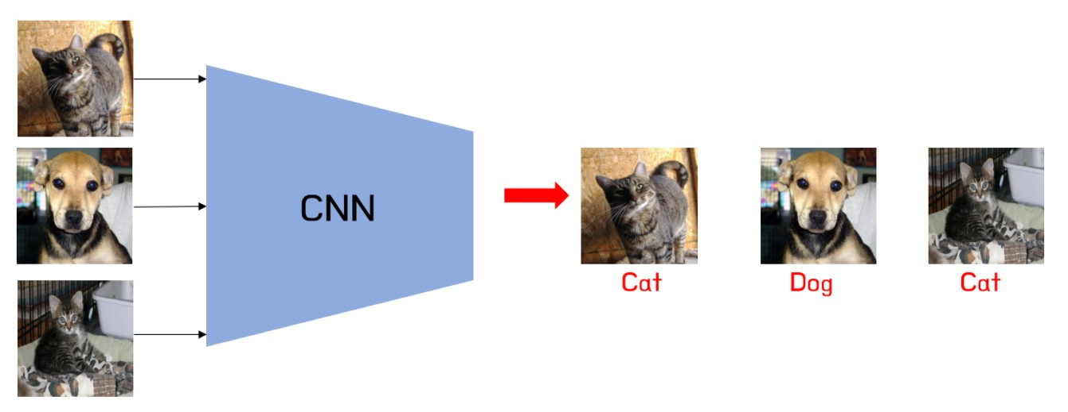
Part IV: MLA
Modelling for Classification
Classification Examples
  Customer behaviour prediction
  Document classification
  Spam filtering
  Image classification
  Web text classification
  Product categorization
  Image sentiment analysis
Notes:
https://vitalflux.com/classification-problems-real-world-examples/

Slide 8
Part IV: MLA
Modelling for Classification
Example of Classification Algorithms
  Logistic Regression
  Decision trees
  Random forest
  XGBoost
  Light GBM
  Voting classifiers
  Artificial neural networks
Notes:
https://vitalflux.com/classification-problems-real-world-examples/
https://medium.com/analytics-vidhya/introduction-to-machine-learning-12328e702711

Slide 9
Part IV: MLA
Modelling
Factors to Choose Correct Algorithm
  The kind of model in use (problem)
  Analysing the available Data (size of training set)
  The accuracy of the model
  Time taken to train the model (training time)
  Number of parameters
  Number of features
  Linearity
Notes:
https://www.geeksforgeeks.org/choosing-a-suitable-machine-learning-algorithm/

Slide 10
Part IV: MLA
Modelling
Choose the best MLA
Understand the problem
  Get deep understanding on the problem to solve. What is the goal? What is the problem all about classification, regression , clustering, or something else? What kind of data you are working with?
Process the Data
  Ensure the data is in the right format for the chosen algorithm. Process and prepare the data by cleaning, clustering, regression, etc.

Slide 11
Part IV: MLA
Modelling
Choose the best MLA
Exploration of Data
  Conduct data analysis to gain insights into the data. Visualizations and statistics helps to understand the relationships within the data
  Metrics Evaluation
  Decide on the metrics that will measure the success of model. It must be chosen the metric that should align better with the problem.

Slide 12
Part IV: MLA
Modelling
Choose the best MLA
Simple models
  One should begin with the simple easy-to-learn algorithms. Simple model provides a baseline for comparison
  Use Multiple Algorithms
  Try to use multiple algorithms to check that one performs on the dataset.

Slide 13
Part IV: MLA
Modelling
Choose the best MLA
Hyperparameter Tuning
  Grid Search and Random Search can help with adjusting parameters choose algorithm that find best combination
  Cross-Validation
  Use cross-validation to get assess the performance of the models. This helps prevent overfitting.

Slide 14
Part IV: MLA
Modelling
Choose the best MLA
Comparing Results
  Evaluate the models' performance by using the appropriated metrics. Compare their performance and choose the one that best align with problem’s goal
  Consider Model Complexity
  Balance complexity of model and their performance. Compare their performance and choose the that generalize better.

Slide 15
Part IV: MLA
Modelling for Classification
Classification Strategies
  Assigning integer to the output
    If there are three classes such as male, female, others, one can follow {0, 1,2} for {male, female, and others} respectively
  Assigning a one-hot encoding vector
    One can assign a one-hot encoding vector to label the output
Notes:
https://vitalflux.com/classification-problems-real-world-examples/

Slide 16
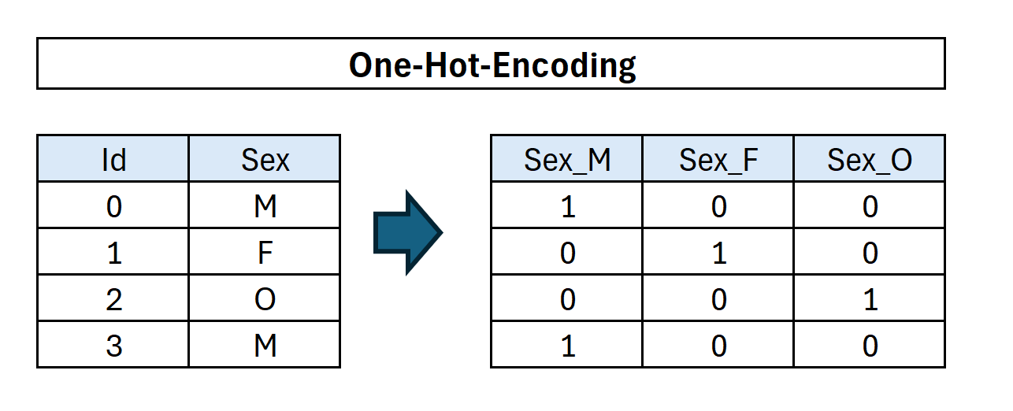
Part IV: MLA
Modelling for Classification
Classification Strategies
  Assigning integer to the output
    If there are three classes such as male, female, others, one can follow {0, 1,2} for {male, female, and others} respectively
  Assigning a one-hot encoding vector
    One can assign a one-hot encoding vector to label the output
The component corresponding to a particular instance’s class or category is set to 1 and all other components are set to 0. Thus, the one-hot encoding vector for the male class will be (1, 0, 0). For female class, it will be (0, 1, 0). For others class, it is (0, 0, 1). Thus, the output labels can be represented as {(1, 0, 0), (0, 1, 0), (0, 0, 1)}
See 4_Data_Manipulation_Modelling_III.ipynb
Notes:
https://vitalflux.com/classification-problems-real-world-examples/

Slide 17
Part IV: MLA
Modelling for Classification
Fit the Model
Fitting the model is the training process. The model go through each row (X) (independent variables) and try to figure out the corresponding expected label (y). In practice it tries to find patterns!
During the evaluation phase (checking the score), the model uses the patterns it has learned!
Notes:
https://www.geeksforgeeks.org/choosing-a-suitable-machine-learning-algorithm/

Slide 18
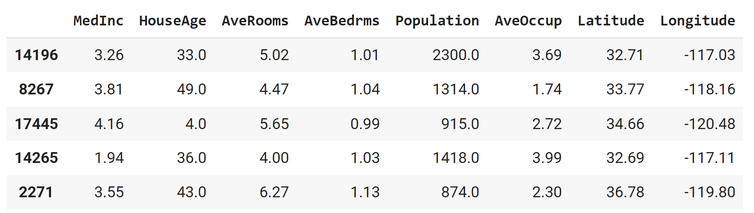
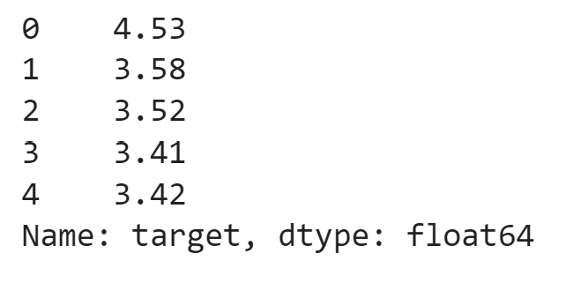
Part IV: MLA
Modelling for Classification
Fit the Model
Fitting the model is the training process. The model go through each row (X) (independent variables) and try to figure out the corresponding expected label (y). In practice it tries to find patterns!
During the evaluation phase (checking the score), the model uses the patterns it has learned!
X_test
y_test
clf=model(X_train, y_train)
Notes:
https://www.geeksforgeeks.org/choosing-a-suitable-machine-learning-algorithm/

Slide 19
Part IV: MLA
Modelling for Classification
Make predictions
  Apply the created model to the test datatset using functions:
  Predict()
    given a trained model, predict the label of a new set of data
  Predict_proba()
    infer the class probabilities (i.e. the probability that a particular data point falls into the underlying classes)

Slide 20
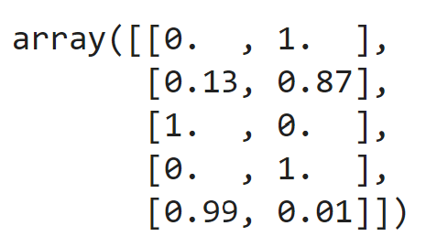

Part IV: MLA
Modelling for Classification
X_test
Make predictions
model.predict(X_test[:5])
model.predict_proba(X_test[:5])

Slide 21
Part IV: MLA
Modelling for Classification
Cross-Validation
  Cross-validation, provides cross-validated accuracy scores.
  Is used to prevent overfitting and promote model generalisation.
  Is a technique used to evaluate the performance of a model on unseen data.
  It involves dividing the available data into multiple folds or subsets.
Remember, overfitting, occurs when a model is trained too well on the training data and performs poorly on new, unseen data.

Slide 22
Part IV: MLA
Modelling for Classification
Cross-Validation
  The number of folds (scoring parameter) is defined (by default it is 5),
  The initial dataset is split up according to these folds, where each fold has a unique set of testing data
  A model is trained and tested for each fold
  Each fold returns a metric for it's test data
  The mean and standard deviation of these metrics can then be calculated to provide a single metric for the process

Slide 23
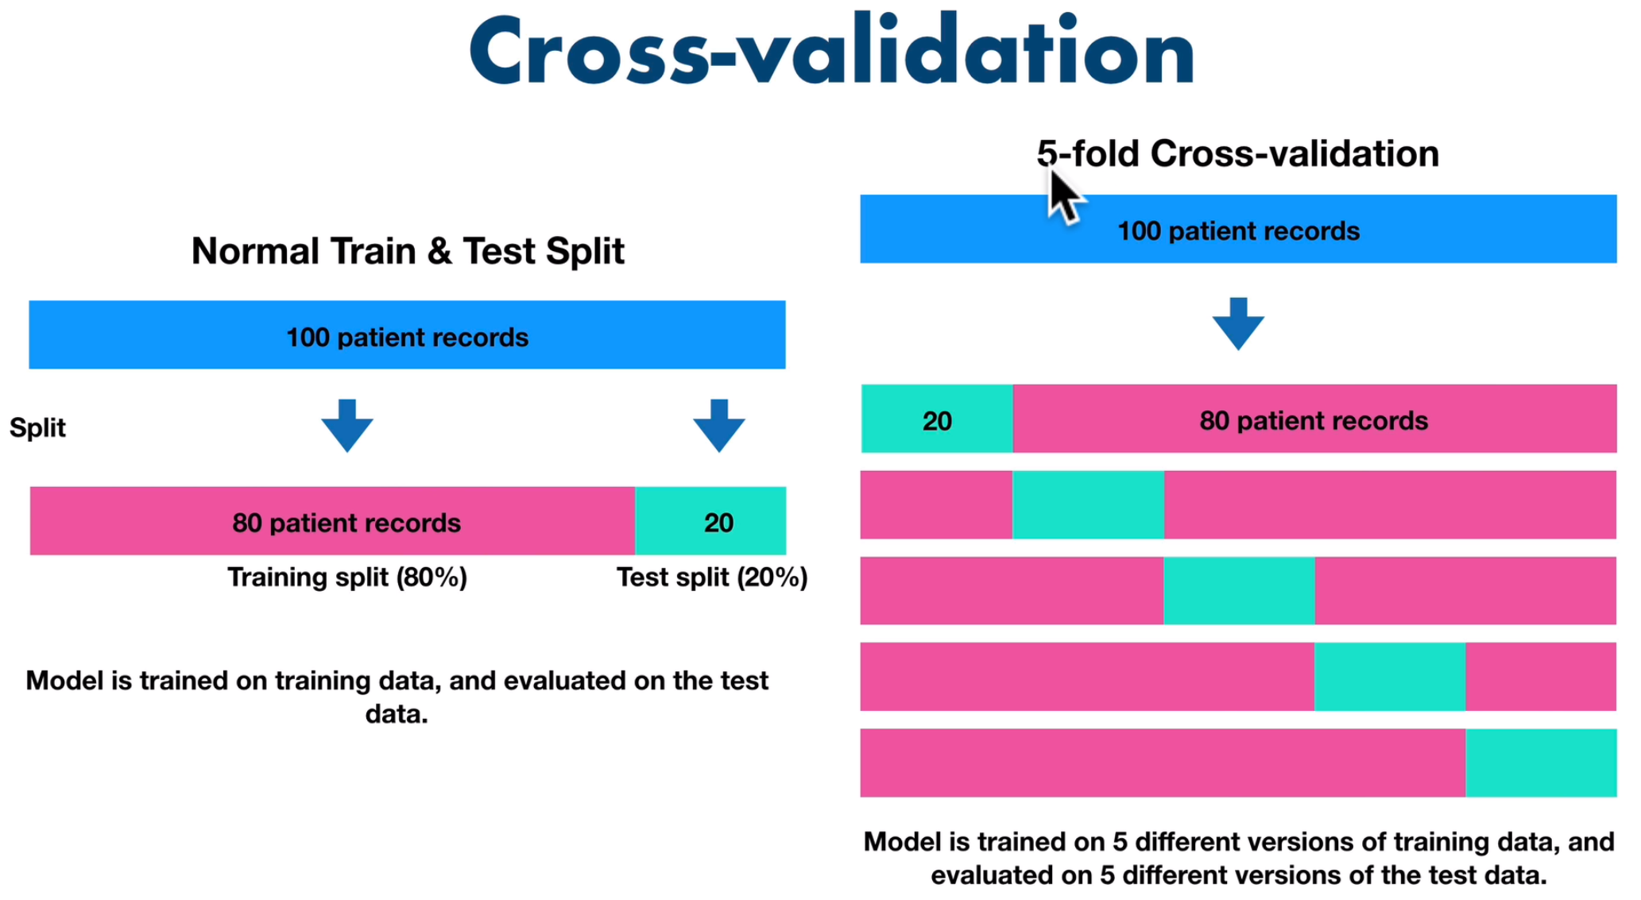
Part IV: MLA
Modelling for Classification
Cross-Validation
  The number of folds (scoring parameter) is defined (by default it is 5),
  The initial dataset is split up according to these folds, where each fold has a unique set of testing data
  A model is trained and tested for each fold
  Each fold returns a metric for it's test data
  The mean and standard deviation of these metrics can then be calculated to provide a single metric for the process

Slide 24
Part IV: MLA
Modelling for Classification
Cross-Validation
  The number of folds (scoring parameter) is defined (by default it is 5),
  The initial dataset is split up according to these folds, where each fold has a unique set of testing data
  A model is trained and tested for each fold
  Each fold returns a metric for it's test data
  The mean and standard deviation of these metrics can then be calculated to provide a single metric for the process
#applied to test dataset
a = rf.score(X_test, y_test)
#apply to 5 folds in original dataset
b = cross_val_score(rf,X,y, cv=5)
#analyse both scores
a,b
Notes:
Action 139

Slide 25
Part IV: MLA
Modelling for Classification
Get practice
  See Jupyter notebook
  5_Modelling_Classification.ipynb
Notes:
Action 139

Slide 26
Part IV: MLA
Modelling for Classification
Evaluate the quality of the predictions
The effectiveness of a machine learning model is measured by its ability to make accurate predictions and minimize prediction errors!
Notes:
https://www.geeksforgeeks.org/overfitting-and-regularization-in-ml/

Slide 27
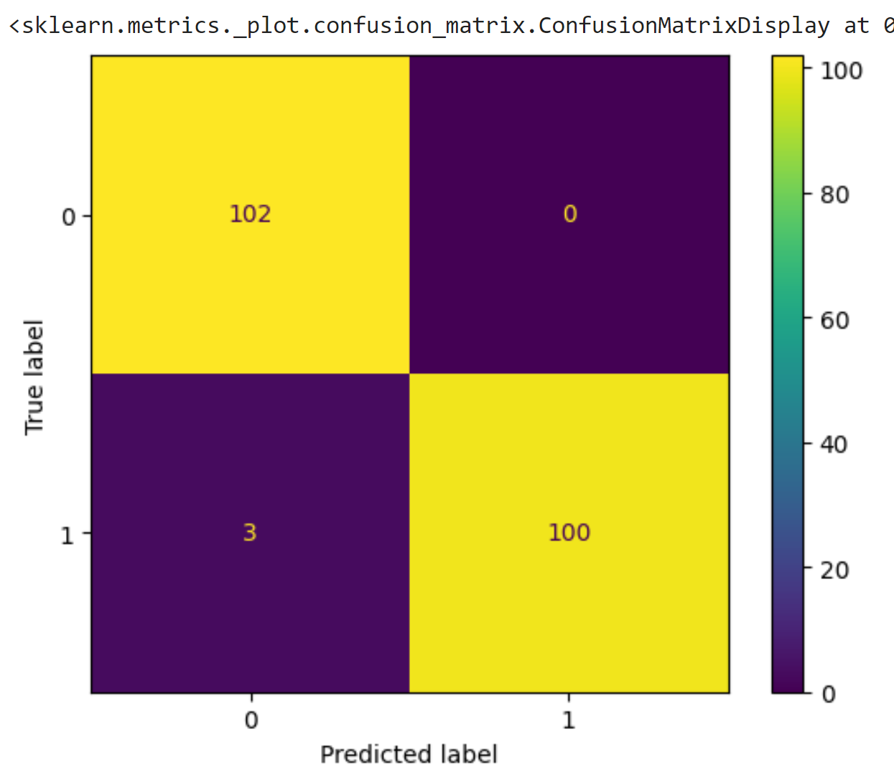
Part IV: MLA
Modelling for Classification
Evaluate the quality of the predictions
  Model score | Scoring Parameter |Metric Functions
Metrics
  Accuracy | Precision | Recall | F1-score
  Area under ROC curve (AUC | ROC)
  Confusion Matrix
  Classification Report
confusion_matrix(expected, predicted)
Notes:
https://www.analyt
Action 1icsvidhya.com/blog/2021/07/metrics-to-evaluate-your-classification-model-to-take-the-right-decisions/

Slide 28
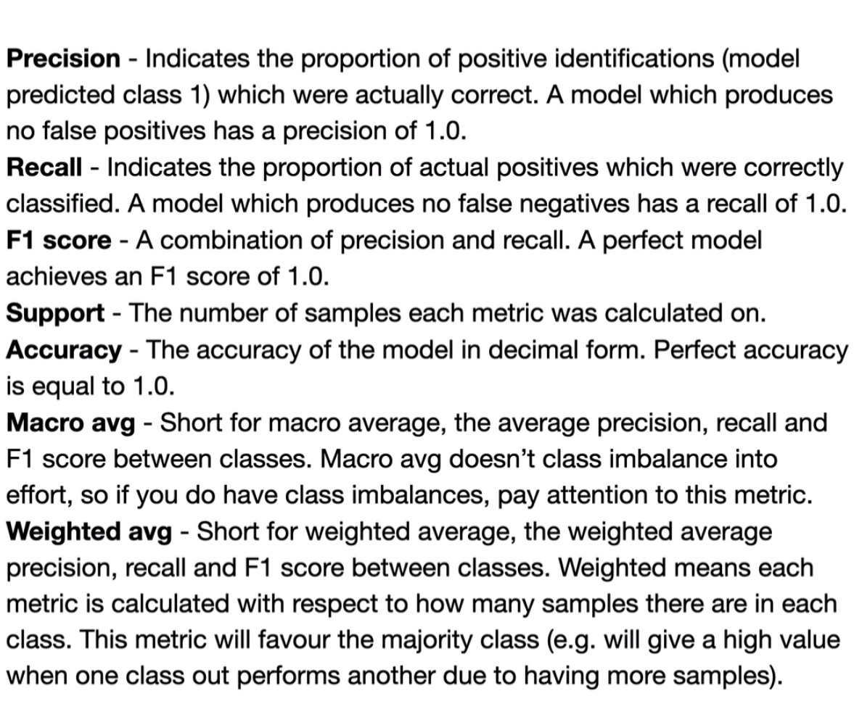
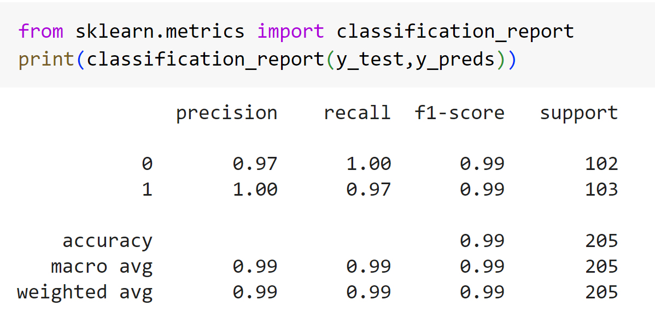
Part IV: MLA
Modelling for Classification
Classification Report
classification_report(expected, predicted)
Notes:
https://www.analyt
Action 1icsvidhya.com/blog/2021/07/metrics-to-evaluate-your-classification-model-to-take-the-right-decisions/

Slide 29
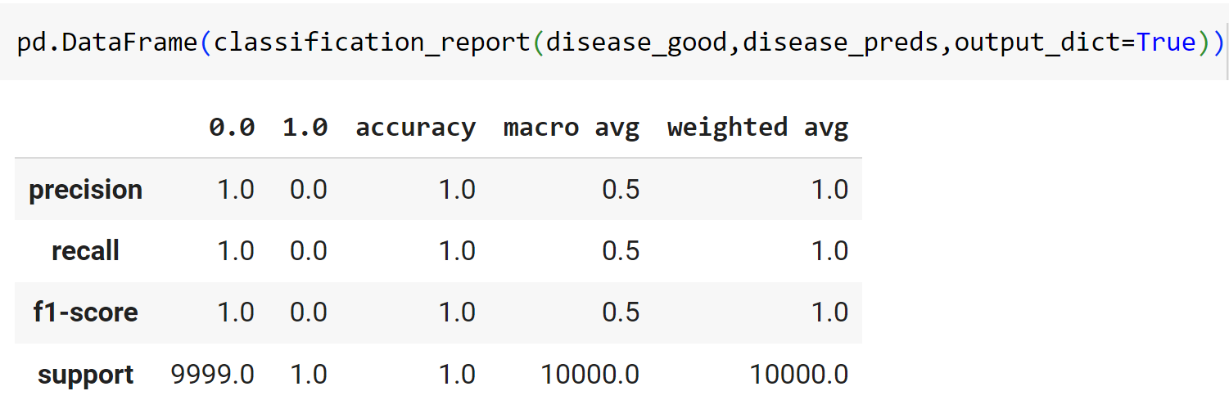
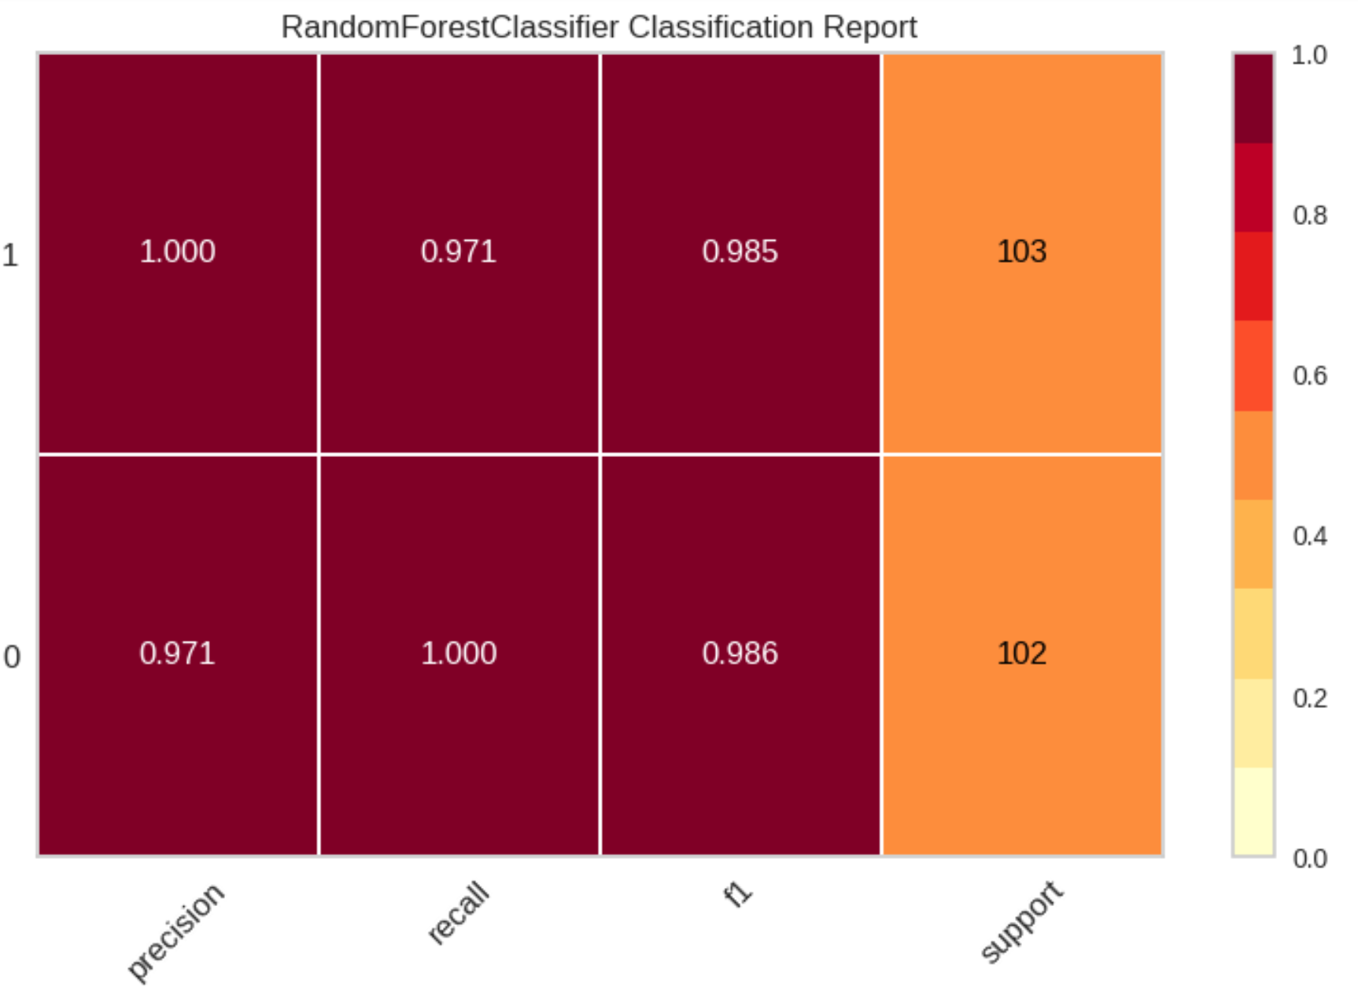
Part IV: MLA
Modelling for Classification
Classification Report Visualization
from yellowbrick.classifier import ClassificationReport
visualizer = ClassificationReport(rf, classes=rf.classes_, support=True)
visualizer.fit(X_train, y_train) # Fit the visualizer and the model
visualizer.score(X_test, y_test) # Evaluate the model on the test data
visualizer.show() # Finalize and show the figure
Notes:
https://www.analyt
Action 1icsvidhya.com/blog/2021/07/metrics-to-evaluate-your-classification-model-to-take-the-right-decisions/

Slide 30
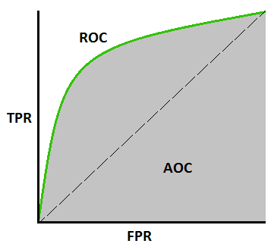
Part IV: MLA
Modelling for Classification
ROC-Curve | AUC
  AUC (Area Under The Curve)
  ROC (Receiver Operating Characteristics) curve.. It is also written as AUROC (Area Under the Receiver Operating Characteristics)
  ROC is a probability curve!
  AUC represents the degree or measure of separability. It tells how much the model is capable of distinguishing between classes.
  Higher the AUC, the better the model is at predicting 0 classes as 0 and 1 classes as 1.
https://towardsdatascience.com/understanding-auc-roc-curve-68b2303cc9c5
Notes:
https://developers.google.com/machine-learning/crash-course/classification/roc-and-auc?hl=pt-br
https://towardsdatascience.com/understanding-auc-roc-curve-68b2303cc9c5

Slide 31
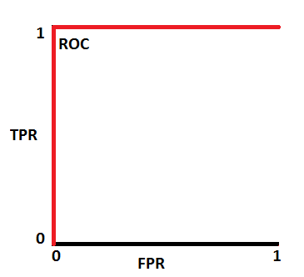
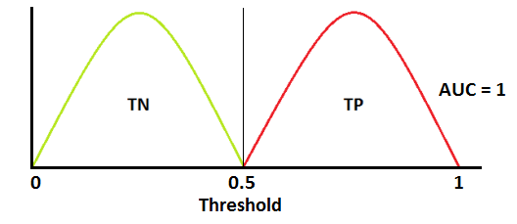
Part IV: MLA
Modelling for Classification
ROC-Curve | AUC (thresholds!!!)
When two curves don’t overlap at all means model has an ideal measure of separability. It is perfectly able to distinguish between positive class and negative class
https://towardsdatascience.com/understanding-auc-roc-curve-68b2303cc9c5
Notes:
https://towardsdatascience.com/understanding-auc-roc-curve-68b2303cc9c5
https://developers.google.com/machine-learning/crash-course/classification/roc-and-auc?hl=pt-br
Thresholds == limiares|limites

Slide 32
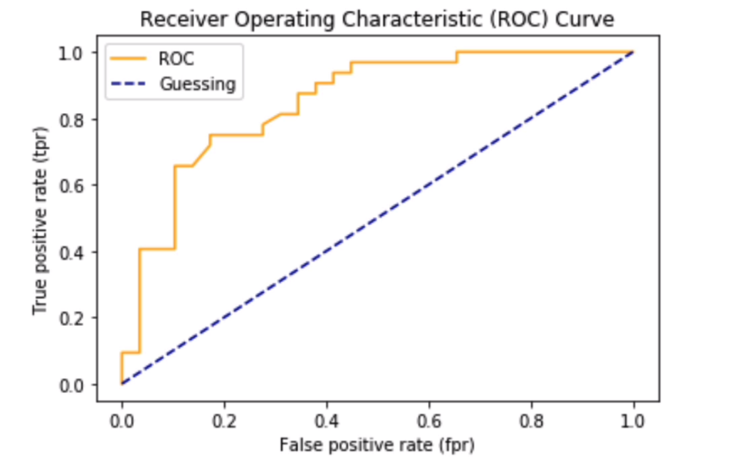
Part IV: MLA
Modelling for Classification
ROC-Curve | AUC (thresholds!!!)
https://towardsdatascience.com/understanding-auc-roc-curve-68b2303cc9c5
Notes:
https://towardsdatascience.com/understanding-auc-roc-curve-68b2303cc9c5
https://developers.google.com/machine-learning/crash-course/classification/roc-and-auc?hl=pt-br
Thresholds == limiares|limites

Slide 33
Part IV: MLA
Modelling for Classification
When the model does not Converge
  Normally when an optimization algorithm does not converge, it is usually because the problem is not well-conditioned, perhaps due to a poor scaling of the decision variables
    Normalize the training data (explore Standardization?)
    Set max_iter to a larger value (default=?)
    Set dual = True (for SVM optimization)
    Use a different solver

Slide 34
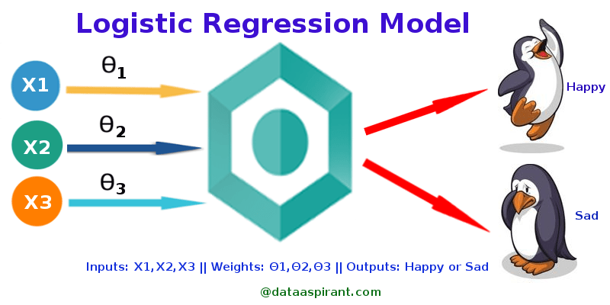
Part IV: MLA
Classification Algorithms
Logistic Regression Algorithm
Fundamental classification technique
Member of linear classifiers (similar to polynomial and linear regression).
Is often used to understand relationships between a dependent variable and one or more independent variables. Typical use-cases for logistic regression have a ‘yes/no’ or a ‘pass/fail’ outcome
𝐱 = (𝑥₁, …, 𝑥ᵣ), y=(0|1)
Outcomes is a range values
Notes:
https://vitalflux.com/classification-problems-real-world-examples/
https://realpython.com/logistic-regression-python/
Simple and Fast

Slide 35
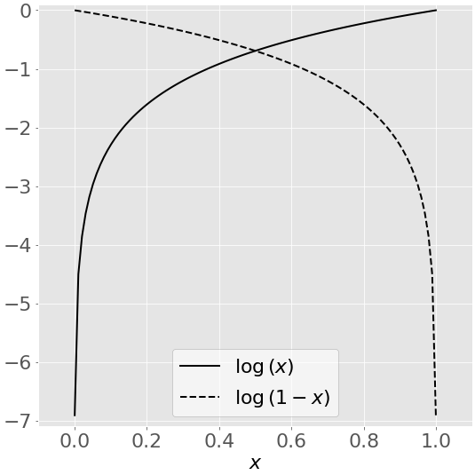
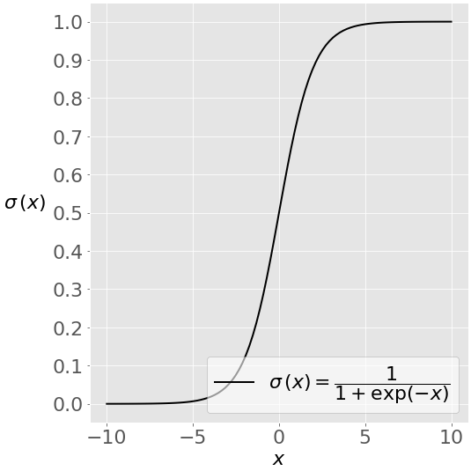
Part IV: MLA
Classification Algorithms
Logistic Regression Algorithm
Uses linear function 𝑓(𝐱) where:
  𝑓(𝐱) = 𝑏₀ + 𝑏₁𝑥₁ + ⋯ + 𝑏ᵣ𝑥ᵣ, where 𝑏₀, 𝑏₁, …, 𝑏ᵣ are the estimators of the regression coefficients (estimators | predicted weights | coefficients)
  determines the best predicted weights 𝑏₀, 𝑏₁, …, 𝑏ᵣ such that the function 𝑝(𝐱) is as close as possible to all actual responses 𝑦ᵢ, 𝑖 = 1, …, 𝑛, where 𝑛 is the number of observations
log(𝑥)
Sigmoid Function
𝐱 = (𝑥₁, …, 𝑥ᵣ), y=(0|1)
Notes:
https://vitalflux.com/classification-problems-real-world-examples/
https://realpython.com/logistic-regression-python/
Simple and Fast

Slide 36
Part IV: MLA
Classification Algorithms
Logistic Regression Algorithm
  See jupyter notebook
  5_Modelling_Classification.ipynb
Implementation in phyton
  Import the model
  Spit the dataset (train, test)
  Create an instance of the model
  Fit model to the data
  Evaluate the model
Notes:
https://vitalflux.com/classification-problems-real-world-examples/
https://realpython.com/logistic-regression-python/
Simple and Fast

Slide 37
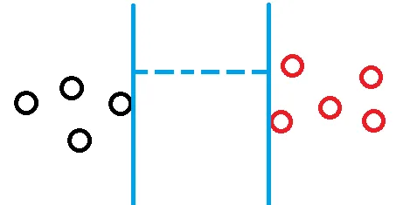
Part IV: MLA
Classification Algorithms
Support Vector Machine (SVM)
Support Vector Machine (SVM) is a supervised learning algorithm that can be used both for classification or regression.
It works for both linear and non-linear calculations of the boundaries
Alternative to other algorithms like Decision Trees, Logistic Regression or Random Forest
Is an algorithm that classifies the data points in two categories
Has the objective of maximizing the distance between them
Hyperparameter kernel (mathematical function)
    kernel: {‘linear’, ‘poly’, ‘rbf’, ‘sigmoid’, ‘precomputed’} or callable, default=’rbf’
Notes:
https://towardsdatascience.com/diving-into-c-support-vector-classification-221ced32e4b4

Slide 38
Part IV: MLA
Classification Algorithms
Support Vector Machine (SVM)
Types
  Linear SVM
    When the data can be precisely linearly separated
  Non-Linear
    when data cannot be separated into two classes by a straight line (in the case of 2D)
Notes:
https://towardsdatascience.com/diving-into-c-support-vector-classification-221ced32e4b4

Slide 39
Part IV: MLA
Classification Algorithms
SVM for Classification
(SVC is an SVM used for classification)
  SVC (C-Support Vector Classifier)
    find the hyperplane that best separates the data points into different classes
  LinearSVC (Linear Support Vector Classifier)
    Uses linear kernel
  NuSVC (Nu-Support Vector Classifier)
    Similar to SVC but uses a parameter to control the number of support vectors
Notes:
https://towardsdatascience.com/diving-into-c-support-vector-classification-221ced32e4b4

Slide 40
Part IV: MLA
Classification Algorithms
When SVM Algorithms
  Effective in high dimensional spaces.
  Where number of dimensions is greater than the number of samples.
  Uses a subset of training points in the decision function (called support vectors), so it is also memory efficient.
  Versatile: different Kernel functions can be specified for the decision function.
Notes:
https://towardsdatascience.com/diving-into-c-support-vector-classification-221ced32e4b4

Slide 41
Part IV: MLA
Classification Algorithms
LinearSVC Algorithm
  See Jupyter Notebook
  5_Modelling_Classification.ipynb
Implementation in phyton
  Import the model
  Spit the dataset (train, test)
  Create an instance of the model
  Fit model to the data
  Evaluate the model
Notes:
https://towardsdatascience.com/diving-into-c-support-vector-classification-221ced32e4b4

Slide 42
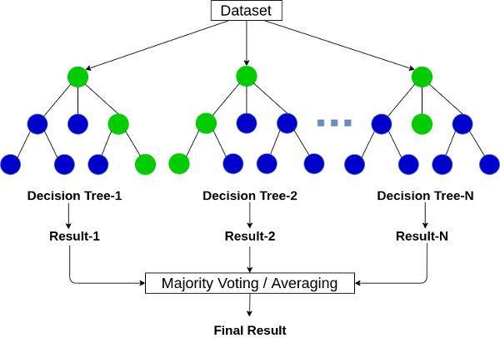
Part IV: MLA
Classification Algorithms
RandomForest Algorithm
  Is an Ensemble method (combining the output of multiple individual models)
  Combines the output of multiple decision trees to reach a single result
  have three main hyperparameters, which need to be set before training. These include node size, the number of trees, and the number of features sampled
  It is a forest of randomly created decision trees
  Used for classification and regression
Notes:
https://towardsdatascience.com/diving-into-c-support-vector-classification-221ced32e4b4

Slide 43
Part IV: MLA
Classification Algorithms
Decision Tree Algorithm
  Is a supervised machine-learning algorithm that can be used either for classification and regression problems
  Is simply a series of sequential decisions made to reach a specific result
  Decision trees start with a basic question, such as, “Should I buy it?”
Notes:
https://towardsdatascience.com/diving-into-c-support-vector-classification-221ced32e4b4

Slide 44
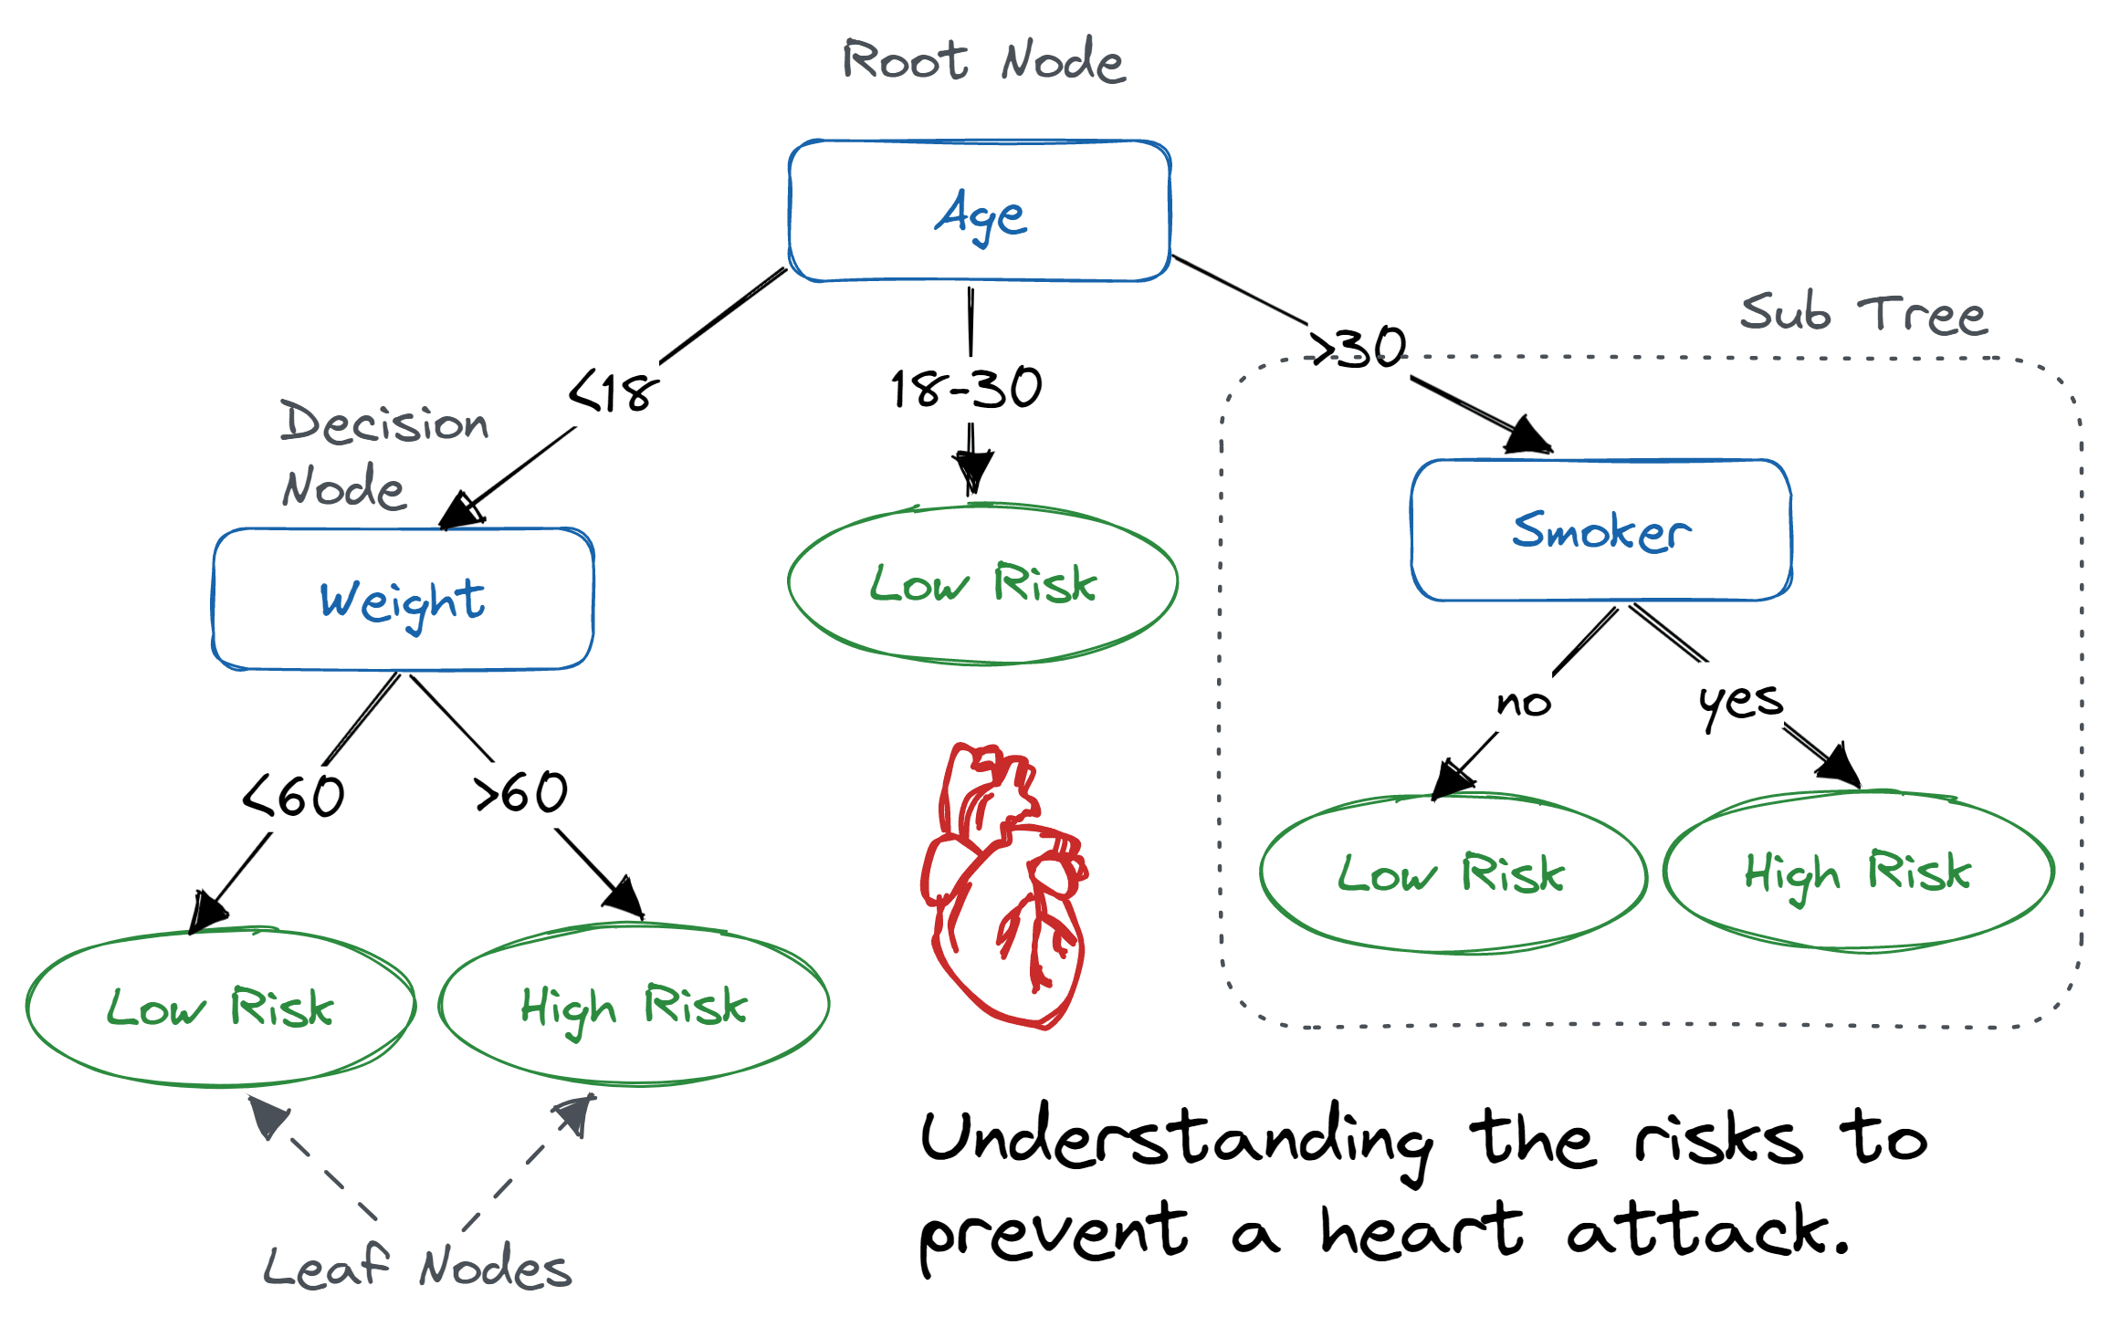
Part IV: MLA
Classification Algorithms
Decision Tree Algorithm
  Is a supervised machine-learning algorithm that can be used either for classification and regression problems
  Is simply a series of sequential decisions made to reach a specific result
  Decision trees start with a basic question, such as, “Should I buy it?”
Notes:
https://www.datacamp.com/tutorial/decision-tree-classification-python

Slide 45
Part IV: MLA
Classification Algorithms
When to use RandomForest Algorithm
  Random Forest is suitable for situations when we have a large dataset, and interpretability is not a major concern
Notes:
https://towardsdatascience.com/diving-into-c-support-vector-classification-221ced32e4b4

Slide 46
Part IV: MLA
Classification Algorithms
RandomForest Algorithm
Decision Tree Algorithm
  See Jupyter notebook
  5_Modelling_Classification.ipynb
Notes:
https://towardsdatascience.com/diving-into-c-support-vector-classification-221ced32e4b4

Slide 47
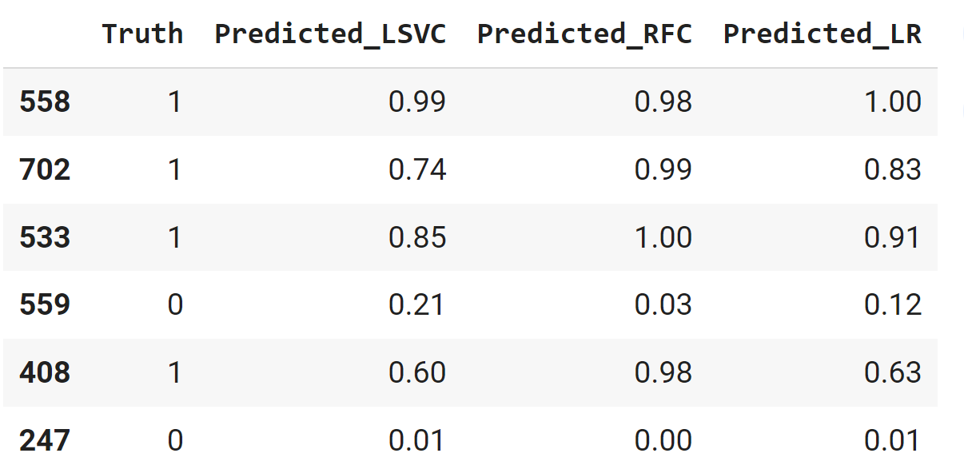
Part IV: MLA
Classification Algorithms
#LSVCA
y_predicted_lsvca = clf.predict_proba(X_test)
#RFCA
y_predicted_rfca=rf.predict_proba(X_test)
#LRA
y_predicted_lra = log_reg.predict_proba(X_test)
Comparing Algorithms
Set different models
Get each own predicting results
Compare them
result = pd.DataFrame({"Truth":y_test, "Predicted_LSVC":y_predicted_lsvca[:,1], "Predicted_RFC":y_predicted_rfca[:,1], "Predicted_LR":y_predicted_lra[:,1]})
Notes:
https://towardsdatascience.com/diving-into-c-support-vector-classification-221ced32e4b4

Slide 48
Part III: MLA
Model Evaluation
What evaluation metric to use?
  Accuracy and error rate?
  Precision and recall
  F1-score and ROC-AUC
  Confusion matrix and classification report
  (Explore)
https://towardsdatascience.com/understanding-auc-roc-curve-68b2303cc9c5
Notes:
https://www.linkedin.com/advice/1/what-evaluation-metrics-most-effective-classification
Thresholds == limiares|limites

Slide 49
Progress
Part I
Artificial Intelligence and Machine Learning
Foundations
Part II
Machine Learning
Part III
Machine Learning Algorithms (I)
Part IV
Machine Learning Algorithms (I)
Part V
Deep Learning & Neural Networks

Slide 50
References
Machine Learning. Tom M. Mitchel, McGraw-Hill, 1997
Machine Learning for Everyone
  https://vas3k.com/blog/machine_learning/
Machine Learning Tutorial
  https://www.simplilearn.com/tutorials/machine-learning-tutorial/machine-learning-steps
What is machine learning and how does it work? In-depth guide
  https://www.techtarget.com/searchenterpriseai/definition/machine-learning-ML

Slide 51
Appendices

Slide 52
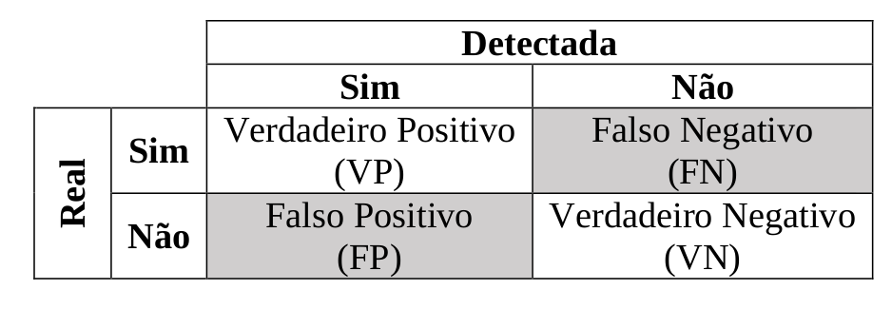
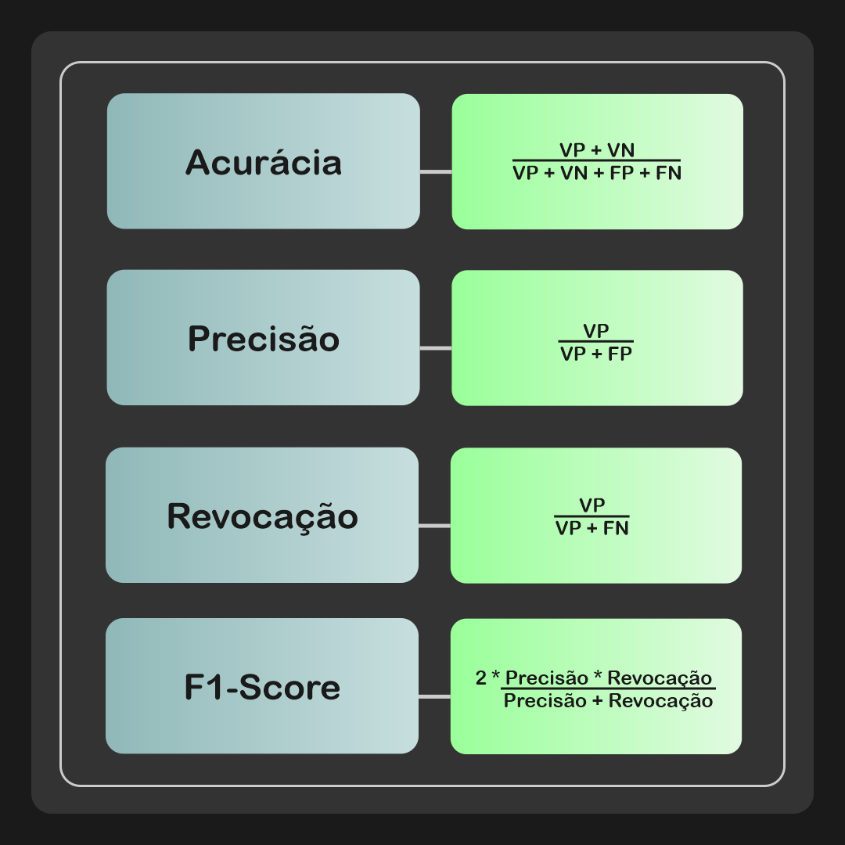
Accuracy: indica a performance geral do modelo. De entre todas as classificações, quantas o modelo classificou corretamente (TP e TN);
Precisão: de entre todas as classificações de classe Positivo
que o modelo fez, quantas estão corretas;
Recall/Sensitivity/Sensibilidade: de entre todas as situações de classe Positivo como valor esperado, quantas estão corretas;
F1-Score: média harmónica entre precisão e recall.
https://deepai.org/machine-learning-glossary-and-terms/harmonic-mean
https://pt.wikipedia.org/wiki/Precis%C3%A3o_e_revoca%C3%A7%C3%A3o
Notes:
https://vitorborbarodrigues.medium.com/m%C3%A9tricas-de-avalia%C3%A7%C3%A3o-acur%C3%A1cia-precis%C3%A3o-recall-quais-as-diferen%C3%A7as-c8f05e0a513c

Slide 53
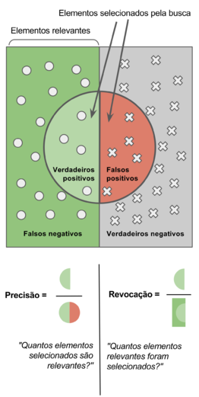
https://pt.wikipedia.org/wiki/Precis%C3%A3o_e_revoca%C3%A7%C3%A3o

Slide 54
